Slide 1
Two Independent Samples T-test

Slide 2
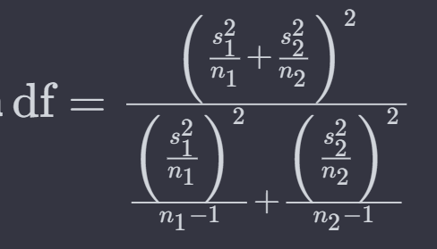
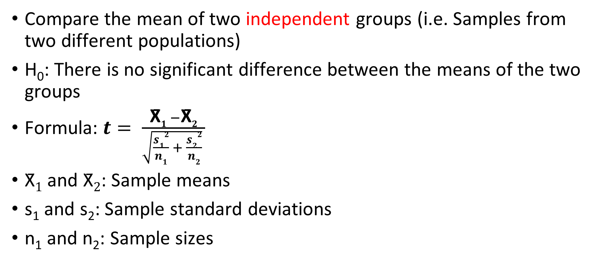
Two Independent Samples T-Test
Compare the mean of two independent groups (i.e. Samples from two different populations)
H₀: There is no significant difference between the means of the two groups
Formula: $t= \frac{\text{X}\text{̄}1 −\text{X}\text{̄}2}{\sqrt{\frac{s12}{n1} + \frac{s22}{n2}} }$
$\text{X}\text{̄}1$ and $\text{X}\text{̄}2$: Sample means
s₁ and s₂: Sample standard deviations
n₁ and n₂: Sample sizes

Slide 3
Example
Marks obtained by two groups of students:
Group A = [85,88,90,92,95,87,89,91,94,86,88,92,90,93,85,89,91,87,92,90,88,93,86,89,91]
Group B = [78,82,80,85,88,81,83,79,84,87,80,82,85,78,81,83,79,82,80,85,78,81,83,79,84,87,80,82,85,78]

Slide 4
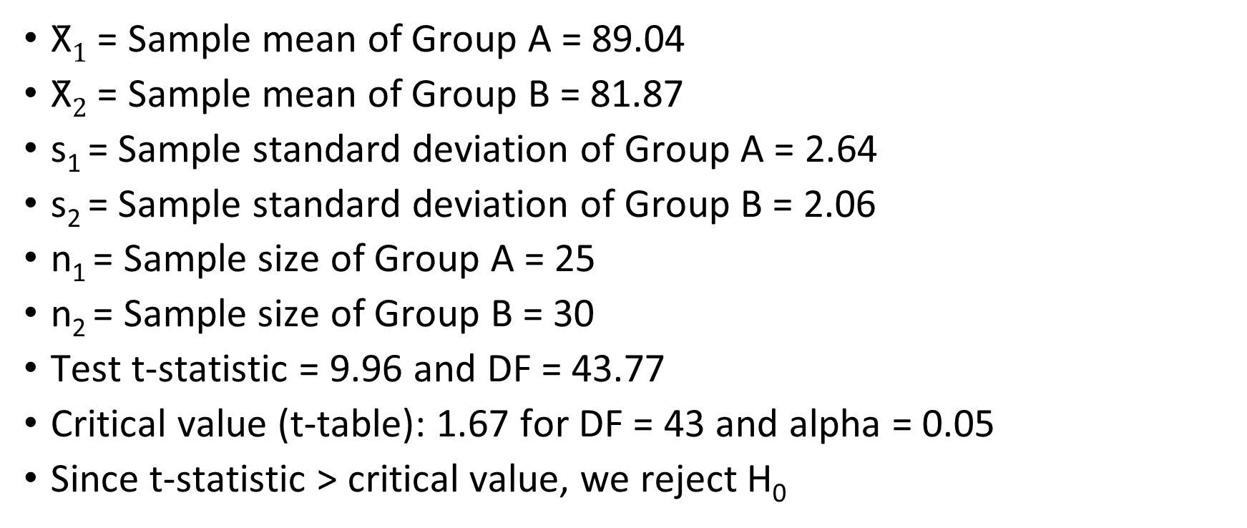
Example
$\text{X}\text{̄}1$ = Sample mean of Group A = 89.04
$\text{X}\text{̄}2$ = Sample mean of Group B = 81.87
s₁ = Sample standard deviation of Group A = 2.64
s₂ = Sample standard deviation of Group B = 2.06
n₁ = Sample size of Group A = 25
n₂ = Sample size of Group B = 30
Test t-statistic = 9.96 and DF = 43.77
Critical value (t-table): 1.67 for DF = 43 and alpha = 0.05
Since t-statistic > critical value, we reject H₀

Slide 5
Paired t-test

Slide 6
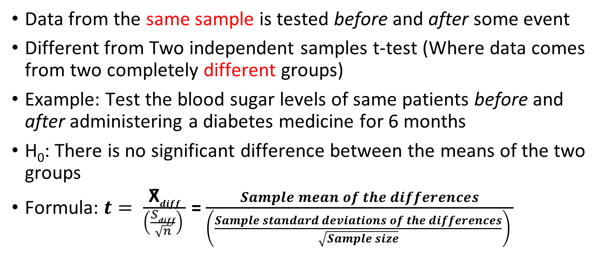
Paired t-test
Data from the same sample is tested before and after some event
Different from Two independent samples t-test (Where data comes from two completely different groups)
Example: Test the blood sugar levels of same patients before and after administering a diabetes medicine for 6 months
H₀: There is no significant difference between the means of the two groups
Formula: $t= \frac{\text{X}\text{̄}diff}{\left(\frac{Sdiff}{\sqrt{n}}\right) }$ = $\frac{Sample mean of the differences}{\left(\frac{Sample standard deviations of the differences}{\sqrt{Sample size}}\right) }$

Slide 7
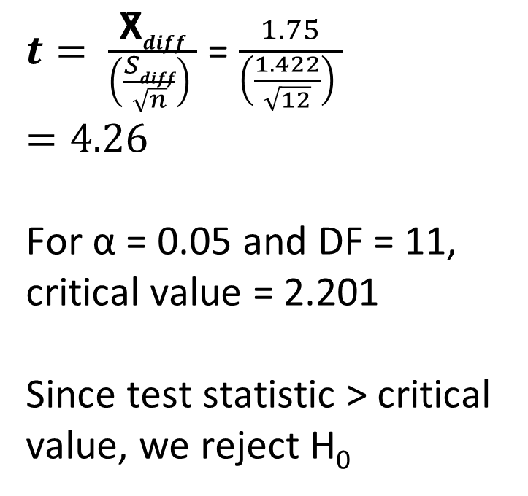
Paired t-test Example
Sample 1 | Sample 2 | Difference
13 | 9 | 4
14 | 11 | 3
14 | 12 | 2
15 | 12 | 3
16 | 14 | 2
17 | 16 | 1
17 | 18 | -1
18 | 18 | 0
19 | 18 | 1
20 | 19 | 1
22 | 20 | 2
23 | 20 | 3
Mean of differences |  | 1.75
Standard deviation of differences |  | 1.422
$t= \frac{\text{X}\text{̄}diff}{\left(\frac{Sdiff}{\sqrt{n}}\right) }$ = $\frac{1.75}{\left(\frac{1.422}{\sqrt{12}}\right) }$
$$=4.26$$
For α = 0.05 and DF = 11, critical value = 2.201
Since test statistic > critical value, we reject H₀

Slide 8
One-way ANOVA

Slide 9
Analysis of Variance (ANOVA)
Are means of three or more groups different?
“One way”: Because we are comparing just one variable across categories
“Two way”: If we compare two variables across categories
Compare variation within each sample, relative to the variation between samples
H₀ = All group means are equal
Formula: Quite complex (See next two slides)

Slide 10
ANOVA Example
Test scores of students:
Teaching Method A: [85, 88, 91, 78, 82]
Teaching Method B: [75, 79, 80, 82, 78]
Teaching Method C: [90, 85, 88, 92, 87]
H0: There are no significant differences in the mean test scores among the three teaching methods
Ha: At least one teaching method has a different mean test score than the others
Mean of Method A: (85 + 88 + 91 + 78 + 82) / 5 = 84.8
Mean of Method B: (75 + 79 + 80 + 82 + 78) / 5 = 78.8
Mean of Method C: (90 + 85 + 88 + 92 + 87) / 5 = 88.4
Grand Mean: (84.8 + 78.8 + 88.4) / 3 = 84

Slide 11
ANOVA Example
SST = Sum of Squares Treatment, measures the variability of group means
SST = Σ (Nt * (Mean of Group t - Grand Mean)^2)
SST = (5 * (84.8 - 84)^2) + (5 * (78.8 - 84)^2) + (5 * (88.4 - 84)^2)
SST ≈ 133.2
SSE = Sum of Squares Error, measures the variability in the groups
SSE = Σ Σ (Xi - Mean of Group i)^2
SSE = (85-84.8)^2 + (88-84.8)^2 + (91-84.8)^2 + (78-78.8)^2 + (82-78.8)^2 + (75-78.8)^2 + (79-78.8)^2 + (80-78.8)^2 + (82-78.8)^2 + (78-78.8)^2 + (90-88.4)^2 + (85-88.4)^2 + (88-88.4)^2 + (92-88.4)^2 + (87-88.4)^2
SSE ≈ 50.8

Slide 12
ANOVA Example
F = (SST / (k - 1)) / (SSE / (N - k))
Where k is the number of groups (3 in this case) and N is the total number of observations (15).
F = (133.2 / 2) / (50.8 / 12)
F ≈ 8.88
Now go to F-table (https://users.sussex.ac.uk/~grahamh/RM1web/F-ratio%20table%202005.pdf), go to column 2, row 12 (See next slide)
Since calculated F-value (8.88) > critical statistic (3.89), we reject the null hypothesis

Slide 13
ANOVA Example: Why column 2, row 14?
Total Degrees of Freedom (df_total): Total number of observations minus 1 = 15 - 1 = 14
Between-Groups Degrees of Freedom (df_between): Number of groups minus 1 = 3 - 1 = 2
Within-Groups Degrees of Freedom (df_within): Subtract df_between from df_total 14 - 2 = 12
We need to go to df_between column and df_within row, hence column 2 and row 12

Slide 14
Chi-Square Test

Slide 15
Chi-Square Test
Chi-square test: A statistical test used to compare observed results with expected results of categorical variables
Three types
Chi-square test of Independence (Are two categories independent? : Are gender and pet preference related?)
Chi-square test of Homogeneity (Is data within a category proportionate?: Do different servers of a company fail roughly at the same rate?)
Chi-square test of Goodness of Fit (Does data fit a particular distribution?: Is tossing a fair coin following binomial distribution?)
Data is arranged in a contingency table (crosstab_tips.py)

Slide 16
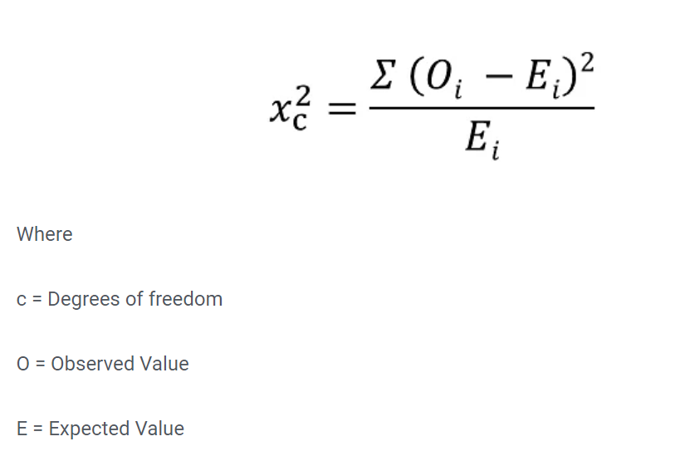
Chi-Square Test – Formula
Degrees of freedom is the number of variables that can vary in a calculation
The degrees of freedom for a Chi-square grid are equal to the number of rows minus one times the number of columns minus one: that is, (R-1)*(C-1). In our 2x2 grid, the degrees of independence will be (2-1)*(2-1), or 1

Slide 17
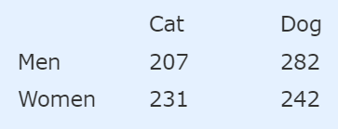
Chi-square Test of Independence
Does gender affect which pet is liked more, for the following data?
Solution: First define Hypotheses
H0: Gender and preference for cats or dogs are independent.
H1: Gender and preference for cats or dogs are not independent.

Slide 18
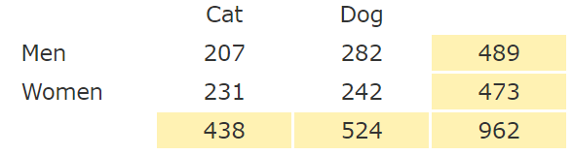
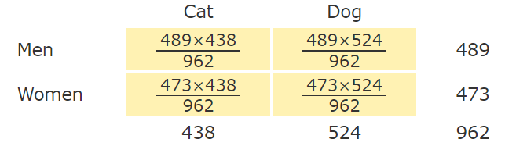
Chi-square Test of Independence
Add up all the row and column values
Calculate “Expected value” for each cell by multiplying each row total by each column total and dividing it by the overall total
The estimated value for each cell is the total for its row multiplied by the total for its column, then divided by the total for the table: that is, (RowTotal*ColTotal)/GridTotal.

Slide 19
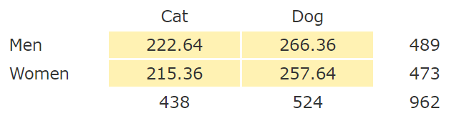
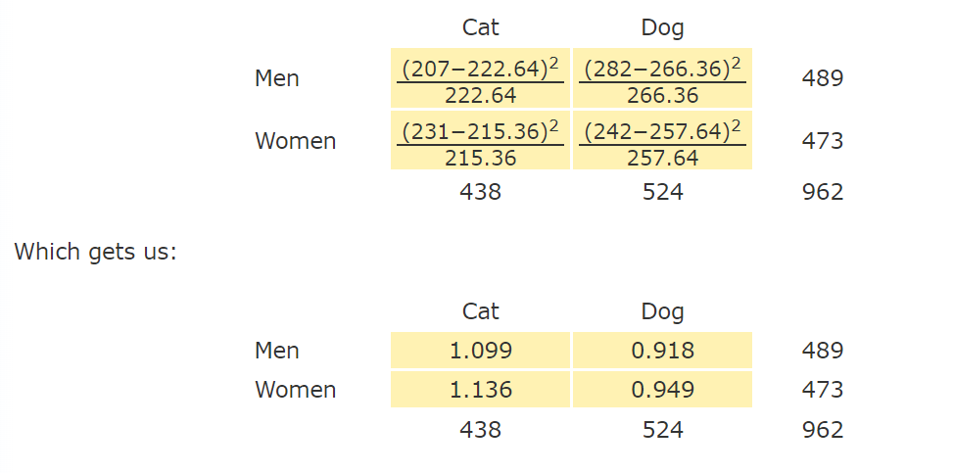
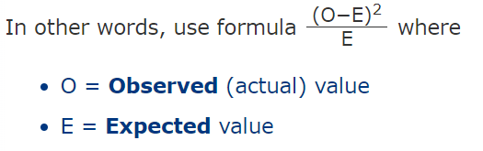
Chi-square Test of Independence
Resulting “Expected values” table
Subtract expected from observed, square it, and divide by expected

Slide 20
Chi-square Test of Independence
Now add up the calculated values
1.099 + 0.918 + 1.136 + 0.949 = 4.102
Chi-Square test statistic is 4.102
Now calculate Degrees of freedom = (row count – 1) x (column count – 1) = (2 – 1) x (2 – 1) = 1
Look up in the Chi-square table (https://people.richland.edu/james/lecture/m170/tbl-chi.html) for DF = 1 and alpha level of 0.05. The value (called as critical value) is 3.841, which is less than our Chi-square value.
Conclusion: Observed value (i.e. our Test statistic) > Critical value (i.e. the Chi-square Table value), so we reject the null hypothesis.

Slide 21
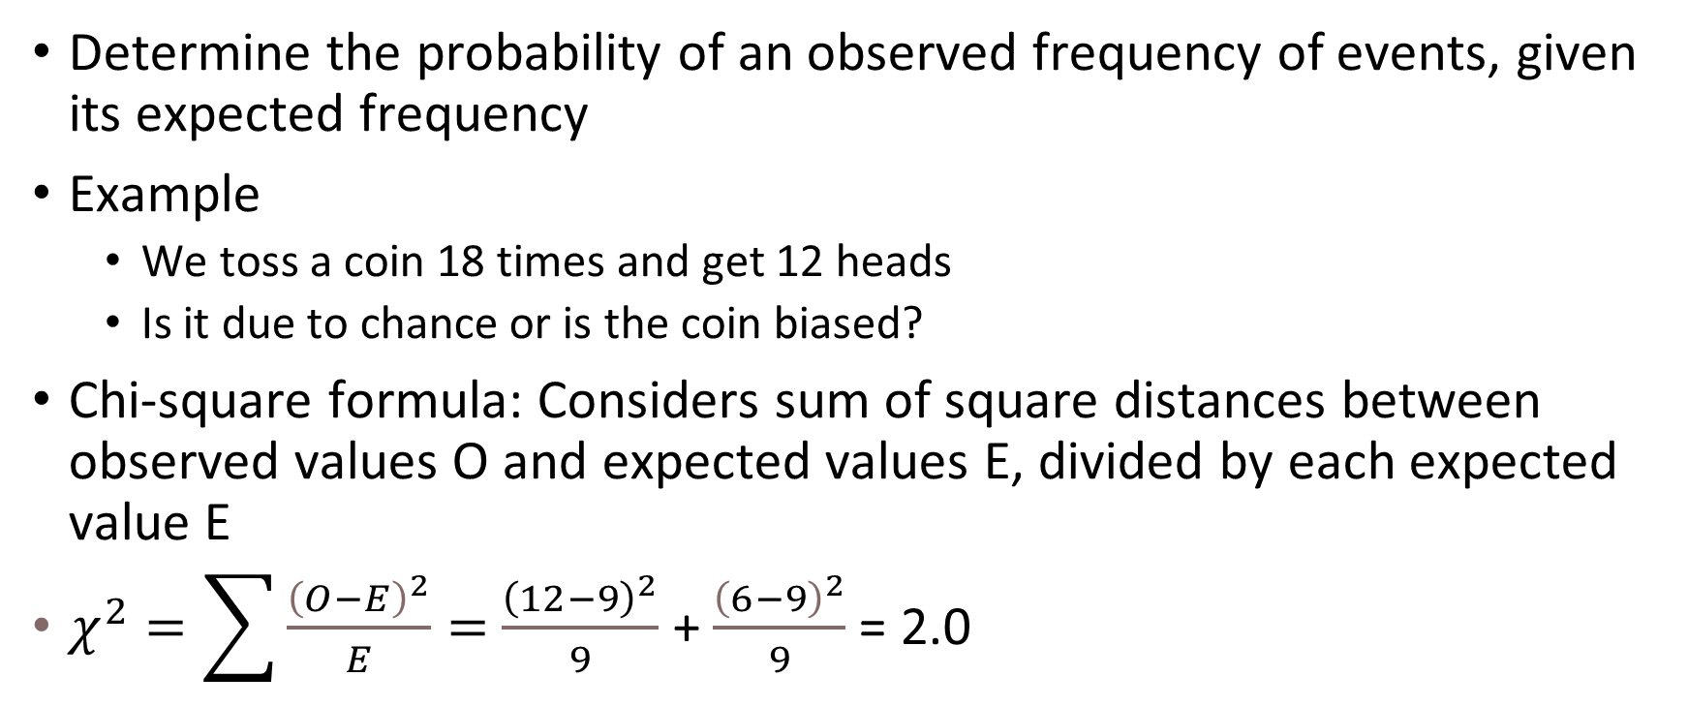
Chi-square Test of Goodness of Fit
Determine the probability of an observed frequency of events, given its expected frequency
Example
We toss a coin 18 times and get 12 heads
Is it due to chance or is the coin biased?
Chi-square formula: Considers sum of square distances between observed values O and expected values E, divided by each expected value E
$χ^{2}=\sum{\frac{{\left(O−E\right)}^{2}}{E}}=$ $\frac{{\left(12−9\right)}^{2}}{9}$ + $\frac{{\left(6−9\right)}^{2}}{9}$ = 2.0
Heads
Tails

Slide 22
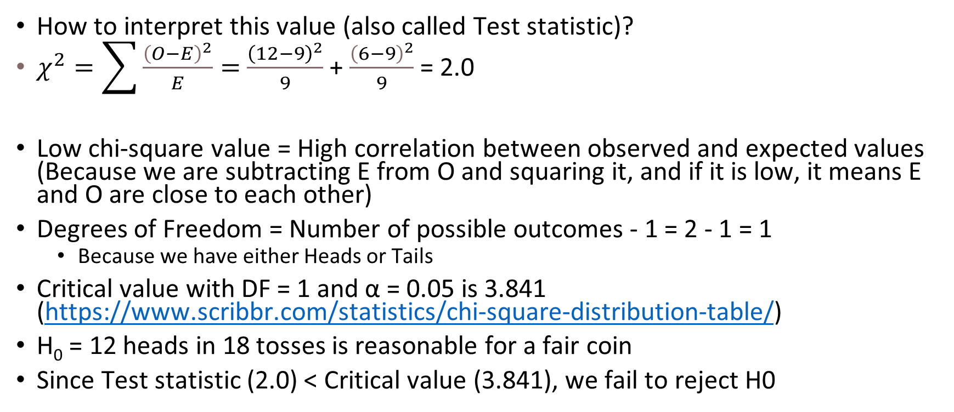
Chi-square Test of Goodness of Fit
How to interpret this value (also called Test statistic)?
$χ^{2}=\sum{\frac{{\left(O−E\right)}^{2}}{E}}=$ $\frac{{\left(12−9\right)}^{2}}{9}$ + $\frac{{\left(6−9\right)}^{2}}{9}$ = 2.0
Low chi-square value = High correlation between observed and expected values (Because we are subtracting E from O and squaring it, and if it is low, it means E and O are close to each other)
Degrees of Freedom = Number of possible outcomes - 1 = 2 - 1 = 1
Because we have either Heads or Tails
Critical value with DF = 1 and α = 0.05 is 3.841 (https://www.scribbr.com/statistics/chi-square-distribution-table/)
H₀ = 12 heads in 18 tosses is reasonable for a fair coin
Since Test statistic (2.0) < Critical value (3.841), we fail to reject H0
Heads
Tails

Slide 23
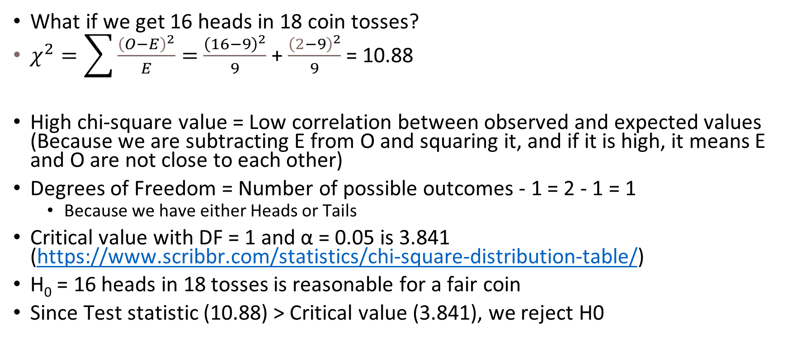
Chi-square Test
What if we get 16 heads in 18 coin tosses?
$χ^{2}=\sum{\frac{{\left(O−E\right)}^{2}}{E}}=$ $\frac{{\left(16−9\right)}^{2}}{9}$ + $\frac{{\left(2−9\right)}^{2}}{9}$ = 10.88
High chi-square value = Low correlation between observed and expected values (Because we are subtracting E from O and squaring it, and if it is high, it means E and O are not close to each other)
Degrees of Freedom = Number of possible outcomes - 1 = 2 - 1 = 1
Because we have either Heads or Tails
Critical value with DF = 1 and α = 0.05 is 3.841 (https://www.scribbr.com/statistics/chi-square-distribution-table/)
H₀ = 16 heads in 18 tosses is reasonable for a fair coin
Since Test statistic (10.88) > Critical value (3.841), we reject H0
Heads
Tails

Slide 24
Chi-Square Test of Homogeneity
A company runs six identical servers for its IT infrastructure
It wants to find out if server failure is occurring at the same rate for all the servers
Assumptions
When a server fails, it does not necessarily mean that it will fail again (When we get Heads in a toss of a coin, it does not say anything about the next toss)
One server’s failure is not impacting any other server in any way
A server is either healthy or has failed – No in-between states
H₀: There is no statistically significant difference between server failure rates

Slide 25
Chi-Square Test of Homogeneity
Server failure actual values are given to us: We need to calculate expected values using them
Server | Observed Failure Count | Expected Failure Count
A | 46 | 40
B | 36 | 40
C | 52 | 40
D | 26 | 40
E | 42 | 40
F | 38 | 40
Total | 240
We expect all servers to have equal failure rate
Since Total Observed Count = 240, we need to divide it by the number of servers, 6
So, Expected Failure Count for each server = 240 / 6 = 40

Slide 26
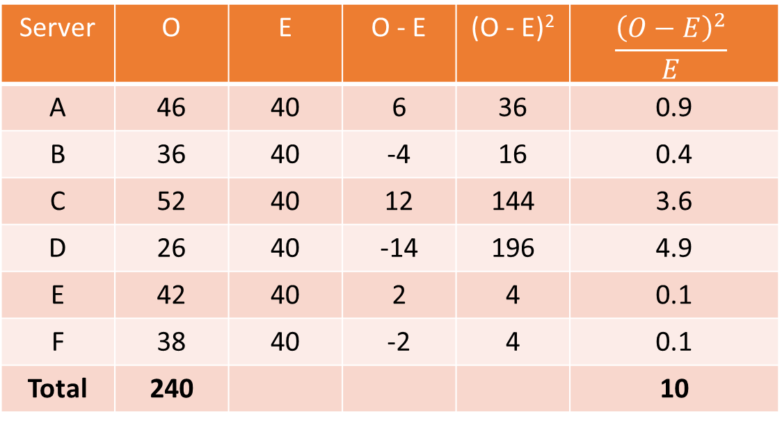

Chi-Square Test of Homogeneity
Finding Critical value using Python
from scipy.stats import chi2
print(chi2.isf(0.05, 5))
Chi-Square calculations $χ^{2}=\sum{\frac{{\left(O−E\right)}^{2}}{E}}$
Chi-square Test statistic = 10
DF = 6 - 1 = 5
α = 0.05
Critical value = 11.07
Since Test statistic < Critical value, we fail to reject H0
Server | O | E | O - E | (O - E)² | $$\frac{{\left(O−E\right)}^{2}}{E}$$
A | 46 | 40 | 6 | 36 | 0.9
B | 36 | 40 | -4 | 16 | 0.4
C | 52 | 40 | 12 | 144 | 3.6
D | 26 | 40 | -14 | 196 | 4.9
E | 42 | 40 | 2 | 4 | 0.1
F | 38 | 40 | -2 | 4 | 0.1
Total | 240 |  |  |  | 10

